Slide 1
CIS 5831 - Pattern Recognition
Music genre classification system
- Tejaswini Vemulapally, Sai Arunanshu Govindarajula

Slide 2
Team Member Responsibilities:
Tejaswini Vemulapally focused on data validation and system development by cleaning and verifying audio data, designing the Flask frontend, initiating the email alert system, and maintaining project documentation and milestones. Sai Arunanshu Govindarajula handled the core machine learning work, including audio feature extraction (MFCC, chroma, spectral features), training ANN, LSTM, and CNN models, integrating the model into Flask, and managing audio preprocessing using FFMPEG.

Slide 3
Introduction:
This research work is related to developing a musical genre classification solution with audio features by using deep learning approaches. A structured feature data analysis is run, and key patterns are displayed to extract more information about the data distribution as well as feature characteristics. Some of the statistics analysis techniques related to data dimensionality reduction are utilized to understand the relationship between various features, as well as understand the grouping of various genres of music in the feature space. It assists in understanding the relevant features of the data that lay a robust foundation for developing models. Aside from using structured features, raw audio files also undergo processing for the extraction of Mel-Frequency Cepstral Coefficients (MFCCs), which are significant for the representation of audio features in terms of their temporal and spectral properties. These features are then utilized for training a Convolutional Neural Network (CNN) for the learning of complex audio patterns that are unique to various genres of audio. This network is then tested on a test data set as well as on real-world audio files to derive its capability of functioning effectively in real-world applications.

Slide 4
Dataset Loading and Initial Analysis:
Dataset loaded from features_3_sec.csv using Pandas. Shape of dataset and number of samples examined. Genre label distribution analyzed. Checked for missing values across all columns. Removed filename column as it has no predictive value. After loading the dataset, an initial analysis was performed to understand its overall structure and quality. Examining the shape of the dataset helped determine the number of samples and features available for training. Analyzing the genre label distribution provided insight into class balance, which is important for building a reliable classification model. Checking for missing values ensured that the dataset did not contain incomplete entries that could affect model performance. Finally, removing the filename column helped eliminate irrelevant information, allowing the model to focus only on meaningful audio features.

Slide 5
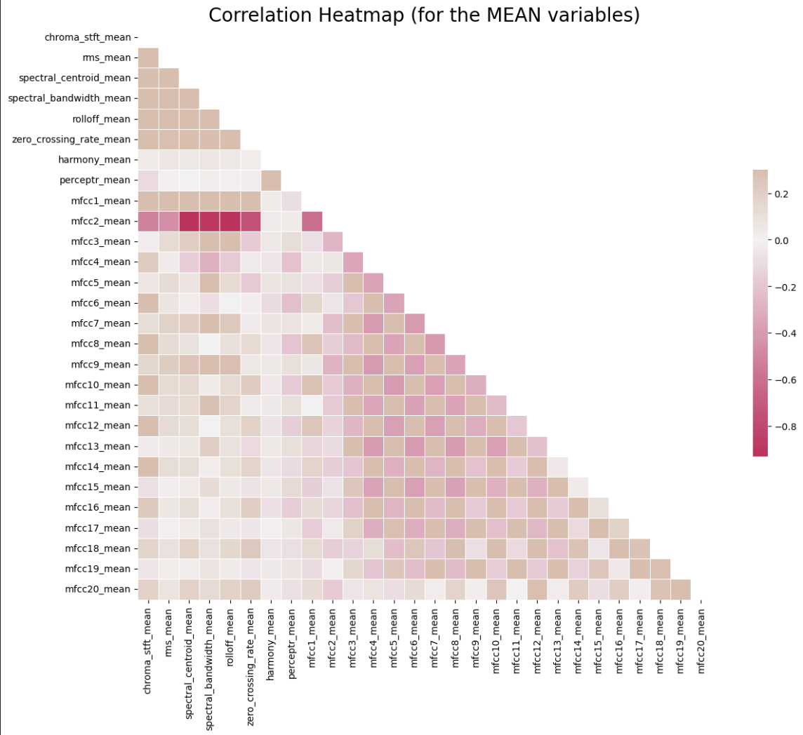
Correlation Analysis and Heatmap:
Before performing the correlation analysis, the dataset was cleaned to ensure that only relevant and consistent numerical features were used. Features containing statistical mean values were selected because they provide stable and representative information about the audio signals. Computing the correlation matrix helped identify relationships between different audio features, including features that were strongly related or redundant. A triangular mask was applied to remove duplicate correlations and improve readability of the heatmap. The resulting heatmap provides a clear visual summary of how audio features interact with each other and helps in understanding feature dependencies that may influence model performance. Selected all feature columns containing “mean”. Computed correlation matrix between selected features. Applied triangular masking to avoid redundancy. Used a diverging color map for clarity. Heatmap saved for documentation and analysis.

Slide 6
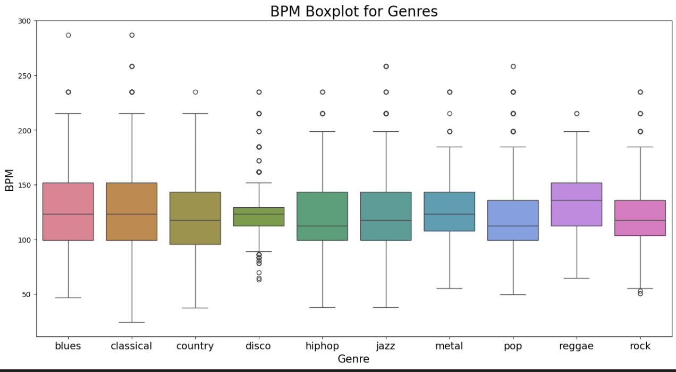
Tempo (BPM) Analysis Across Genres:
Tempo is a key musical feature that varies significantly between genres. To study this, a boxplot was created comparing BPM values for each genre label. The visualization highlights differences in central tempo tendencies. It also shows the spread and presence of outliers within genres. Some genres exhibit consistently higher tempos, while others are slower. This analysis helps connect musical intuition with numeric feature patterns.

Slide 7
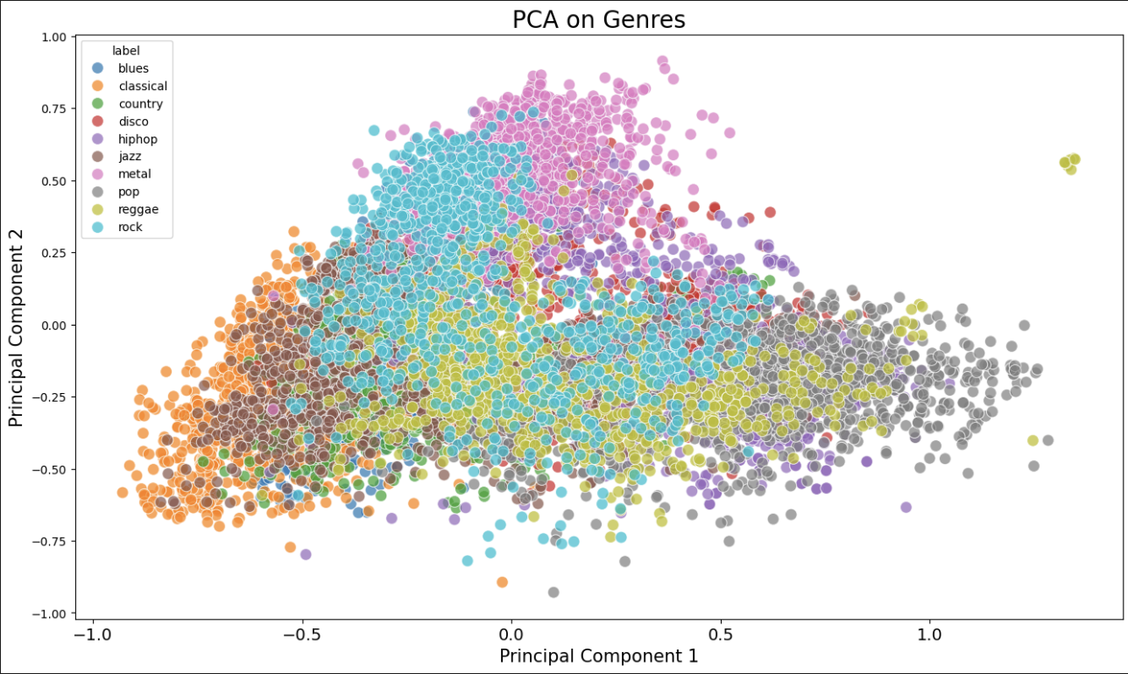
Feature Scaling and PCA Visualization:
Features normalized using MinMaxScaler. Scaling ensures fair contribution of all features. PCA applied to reduce data to two components. PCA output combined with genre labels. Scatter plot generated to visualize clustering.

Slide 8
Interpretation of PCA Results:
The PCA scatter plot provides a simplified view of the dataset in two dimensions. Each point represents a music sample positioned by its principal components. Some genres appear in compact clusters, indicating similar feature patterns. Other genres overlap, showing that their audio characteristics are harder to separate. This overlap suggests that perfect classification may be challenging. Overall, PCA helps set realistic expectations before model training begins. From the PCA plot from the previous slide, it is evident that some genres form relatively dense and localized regions, which indicates that their audio features share strong similarities. Genres such as classical and metal show partial separation along the principal components, suggesting that their spectral and temporal characteristics are more distinctive. However, several genres like pop, rock, and disco exhibit significant overlap, meaning their feature representations are closely related. This overlap highlights why genre classification is a challenging task, as boundaries between certain genres are not clearly defined. The visualization reinforces the need for a powerful nonlinear model, such as a CNN, to capture complex patterns beyond what linear dimensionality reduction can reveal.

Slide 9
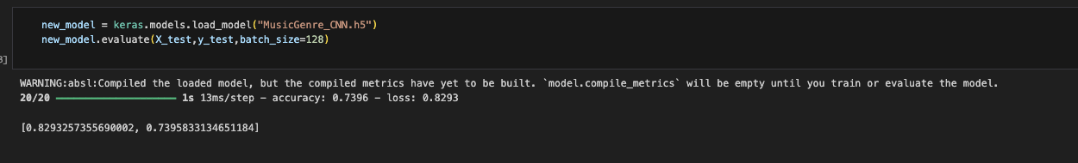
MFCC Extraction from Raw Audio:
Audio loaded using Librosa at fixed sample rate Each track divided into equal time segments MFCCs extracted for each segment Segment-wise features improve temporal learning Data saved into structured JSON format.

Slide 10
Model Architecture:
CNN Model Architecture and Training: In this work, a deep CNN model is designed to learn discriminative patterns of MFCC feature maps using multiple convolutional layers that hierarchically extract audio representations. Such convolutional layers allow the network to capture both low- and high-order features related to different genres of music. To stabilize training and improve the convergence speed, batch normalization layers have been included. Dropout has been used to prevent overfitting by randomly disabling neurons during training. After feature extraction, a dense layer then aggregates the learned representations before classification. A softmax output layer, in the end, provided probability scores across all ten categories of music genres so that the network can make confident and interpretable predictions. The CNN model was designed to learn patterns from MFCC feature maps. Multiple convolutional layers extract hierarchical audio representations. Batch normalization stabilizes training and improves convergence speed. Dropout layers reduce overfitting by randomly disabling neurons. A dense layer combines learned features before classification. The softmax output layer predicts probabilities for ten music genres.

Slide 11
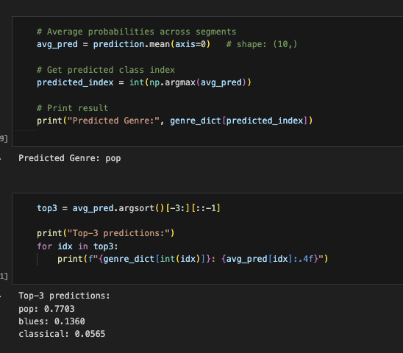
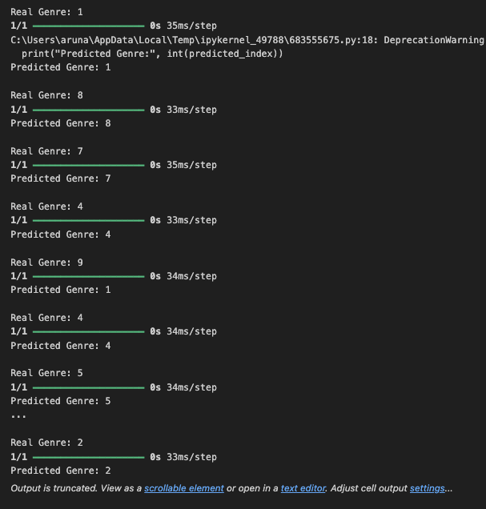
Model Evaluation and Testing:
The trained model was evaluated using a held-out test dataset. Accuracy and loss curves were analyzed to assess learning behavior. Early stopping prevented unnecessary training once validation performance stabilized. The final model was saved and reloaded to confirm persistence. Random test samples were predicted to manually verify results. Performance consistency confirmed that the model generalized well.

Slide 12
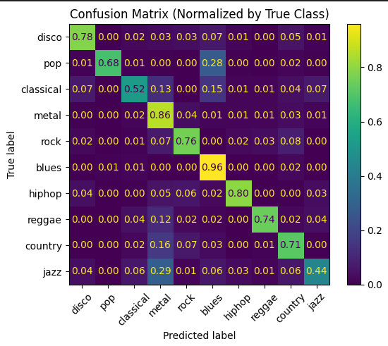
Results:
Confusion Matrix: The confusion matrix highlights where the model struggles, not just overall accuracy. It provides insight into genre similarity and limitations of MFCC-based representations.

Slide 13
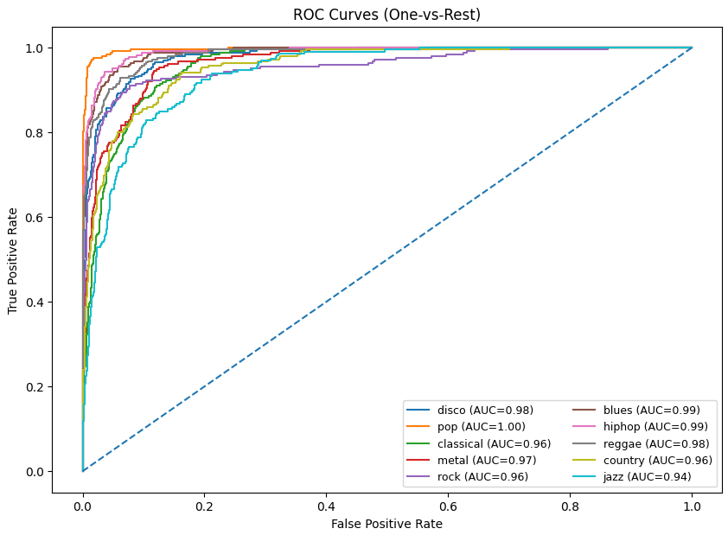
Results:
ROC Curves: ROC curves confirm that the model’s predictions are probabilistically meaningful, not just correct by chance. High AUC values indicate that MFCC features are effective for genre discrimination.

Slide 14
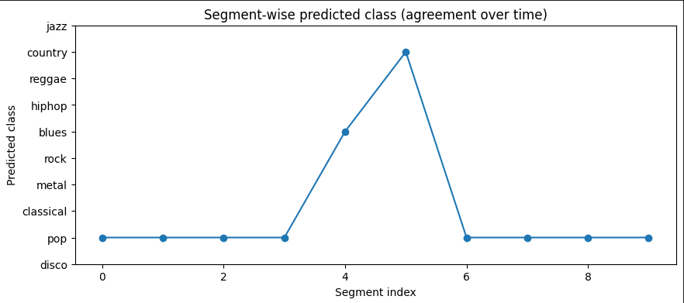
Results:
Segment-Wise Predicted Class: Validates the segment-averaging strategy used during inference. Shows that the model captures both local variations and global genre identity.

Slide 15
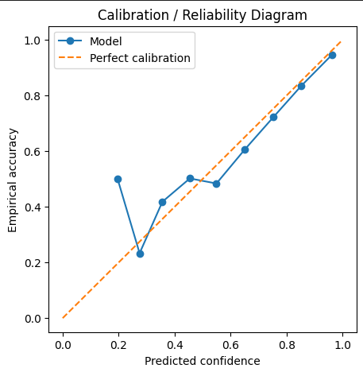
Results:
Calibration & Reliability Diagram: Demonstrates that the model is not over-confident. Indicates that predicted probabilities can be trusted, which is important for real-world deployment.

Slide 16
Conclusion:
This project successfully developed a complete music genre classification pipeline, starting from dataset exploration and preprocessing to model deployment. Audio features were carefully analyzed, cleaned, and visualized using statistical methods, correlation analysis, and dimensionality-reduction techniques to gain meaningful insights into the data. Both pre-extracted features and raw audio signals were utilized, with MFCCs extracted directly from audio files to capture important spectral and temporal characteristics. Multiple deep learning models, including ANN, LSTM, and CNN, were implemented and evaluated, with the CNN achieving the strongest performance. The trained model was integrated into a Flask-based web application capable of handling real-time audio uploads and predictions. Reliable audio preprocessing with FFMPEG ensured system stability and scalability. Overall, the project demonstrates a well-structured, end-to-end solution for music genre classification that is effective, practical, and ready for real-world use.

Slide 17
DEMONSTRATION

Slide 18
Presentation Video - https://youtu.be/amlSIy4KrkE
Demo Video - https://youtu.be/j7CRVgZhN4I

Slide 19
Thank You!!

